Slide 1
Coursera IBM Coursera Data Science Capstone Final Report presented by Andres Aguirre

Slide 2
The Problem What type of restaurant to open in Downtown Toronto depending on the neighborhood? In order to open a restaurant of a certain type the idea is to explore the existing restaurants in the different Downtown Toronto's Neighborhoods. This will be based on restaurant types (i.e. Mexican, Sushi, French) available in each neighborhood and on ratings, price range and social activity of regular restaurant customers in those areas. Audience / Business Objective This would be of interest to entrepreneurs wanting to open a new restaurant, so that they can clearly define the type of restaurant to open based on the current competitive landscape in a given neighborhood. This will increase the chances of success of such venture, for example, by not trying to open a sushi restaurant in an neighborhood already crowded by such type of restaurant or by incorrectly position a price range depending on the competing alternatives on each neighbourhood.

Slide 3
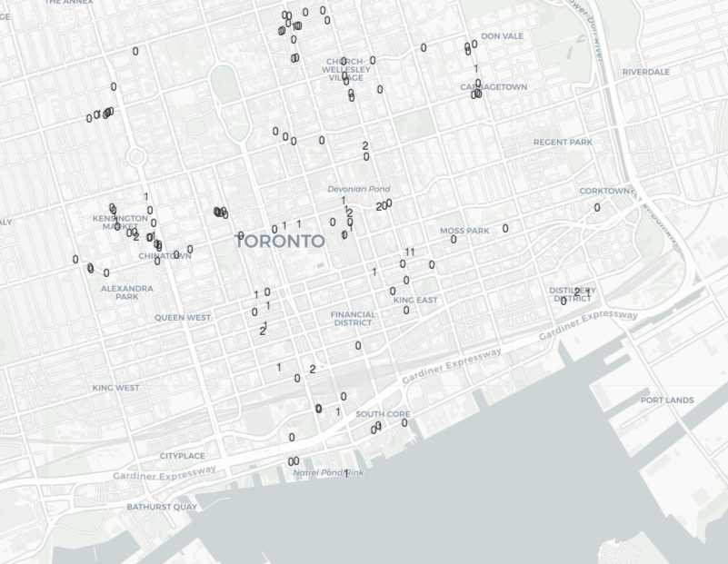
Results and Conclusion By using an unsupervised machine learning algorithm like K-Prototypes, the Restaurants in Downtown Toronto can be classified in 3 clusters> The different restaurant categories (Restaurant features) have been grouped into: Food Restaurants or Niche/Ethnic Restaurants (Cluster 0 Local and International Restaurants (Cluster 1) International Restaurants (Cluster 2).

Slide 4
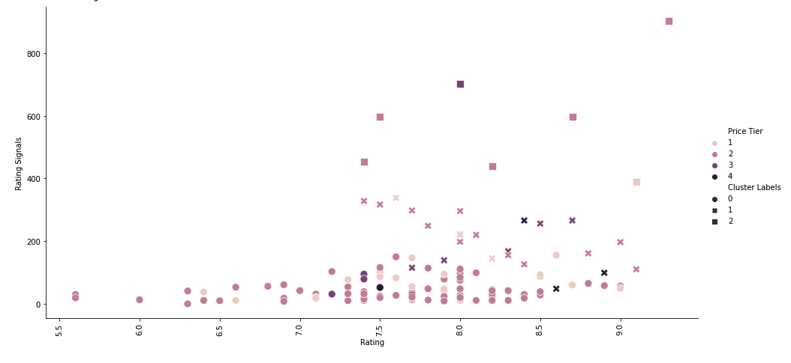
Results and Conclusion The Rating Signals, Rating and Price Tier features are plotted below. As stated in the Discussion section, the scatter plot shows that: Cluster 0: Fast Food Restaurants or Niche/Ethnic Restaurants that mostly offer value for money. Cluster 1: Best Rated Fancy Local and International Restaurants Cluster 2: Best Rated and Recommended International Restaurants

Slide 5
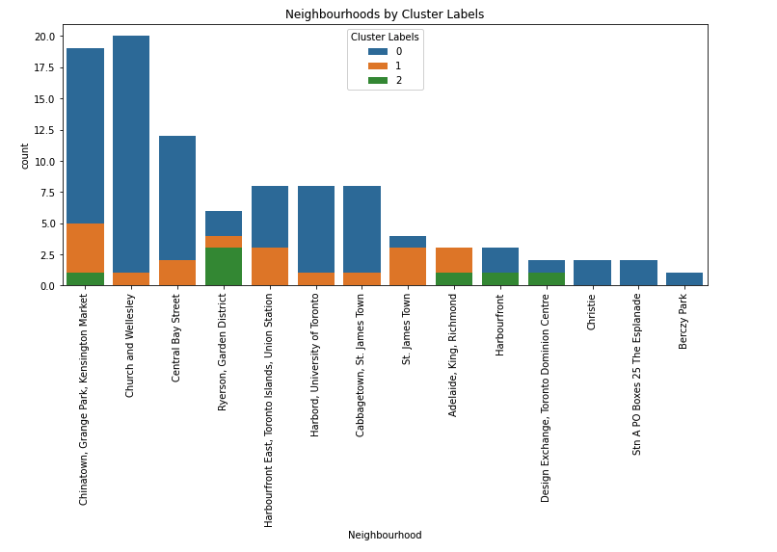
Results and Conclusion This cluster analysis can be used by entrepreneurs trying to open a restaurant in Dowtown Toronto area. For example what type of restaurant should an entreprenuer open in Central Bay Street? Looking at the Neighbourhoods by Cluster Labels countplot, it could be a Cluster 0 or Cluster 1 type of restaurant, since it seems that there is room to grow on those types of restaurantes compared to Church and Wellesley neighbourhood. If an entrepenuer wants to open a restaurant with high customer engagement and word of mouth (Cluster 2), then Garden District or Harbourfront would be the suggested Neighbourhoods, as long as the restaurant is a quality International Restaurant.

